Slide 1

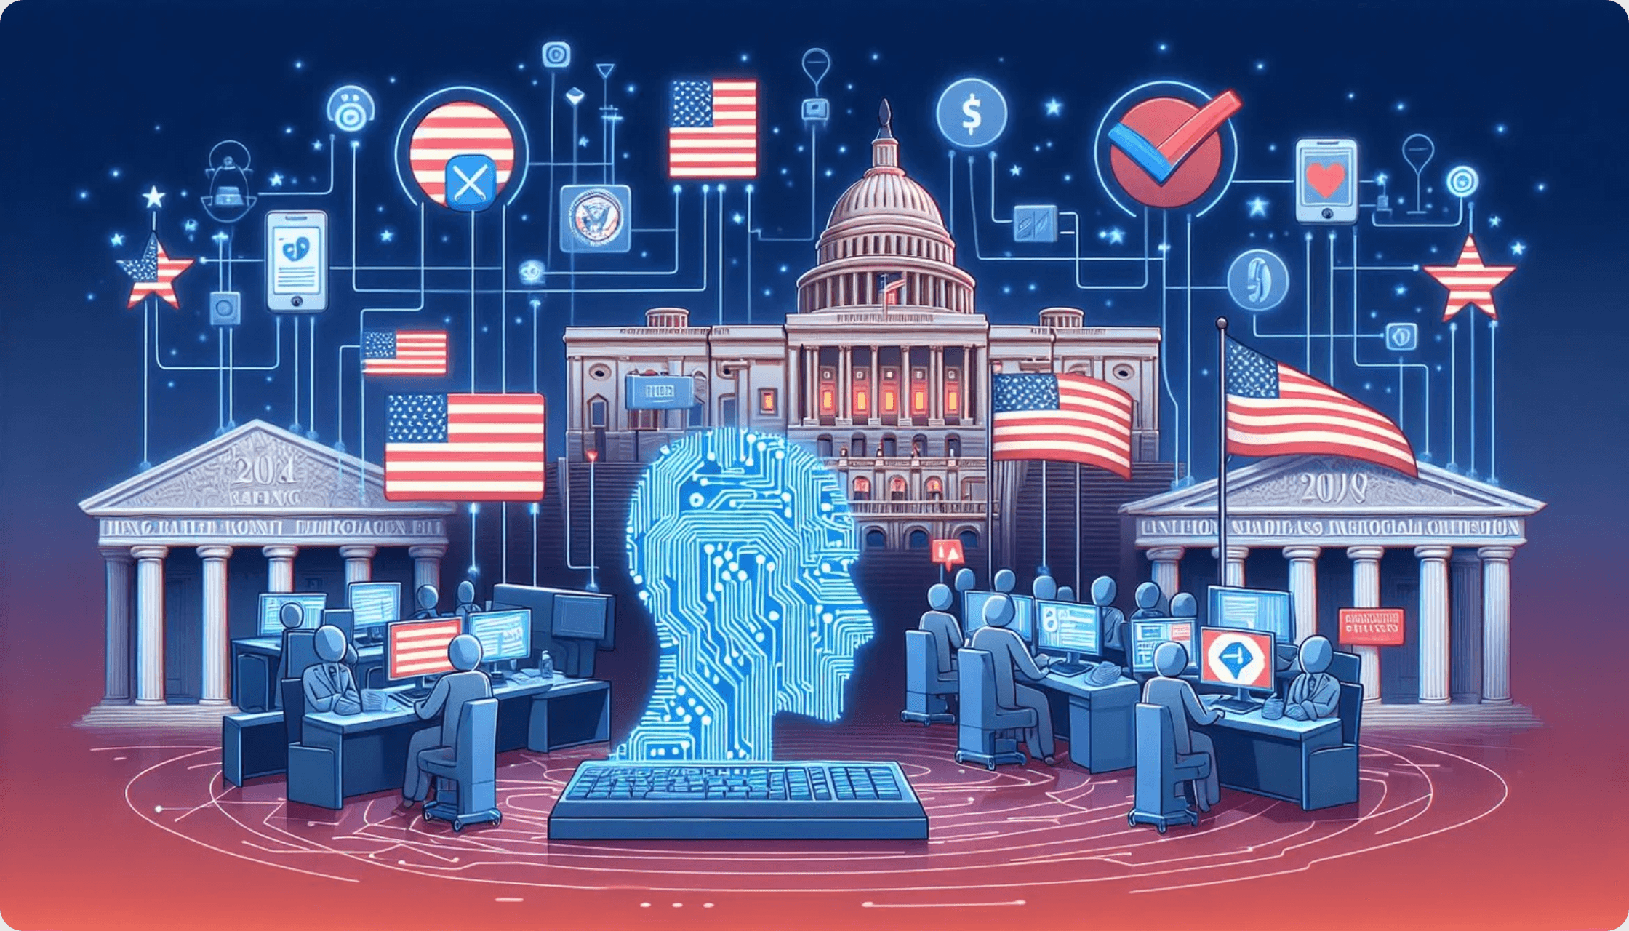
AI for Politics
A Primer
Understanding the Technology and its Political Implications

Slide 2

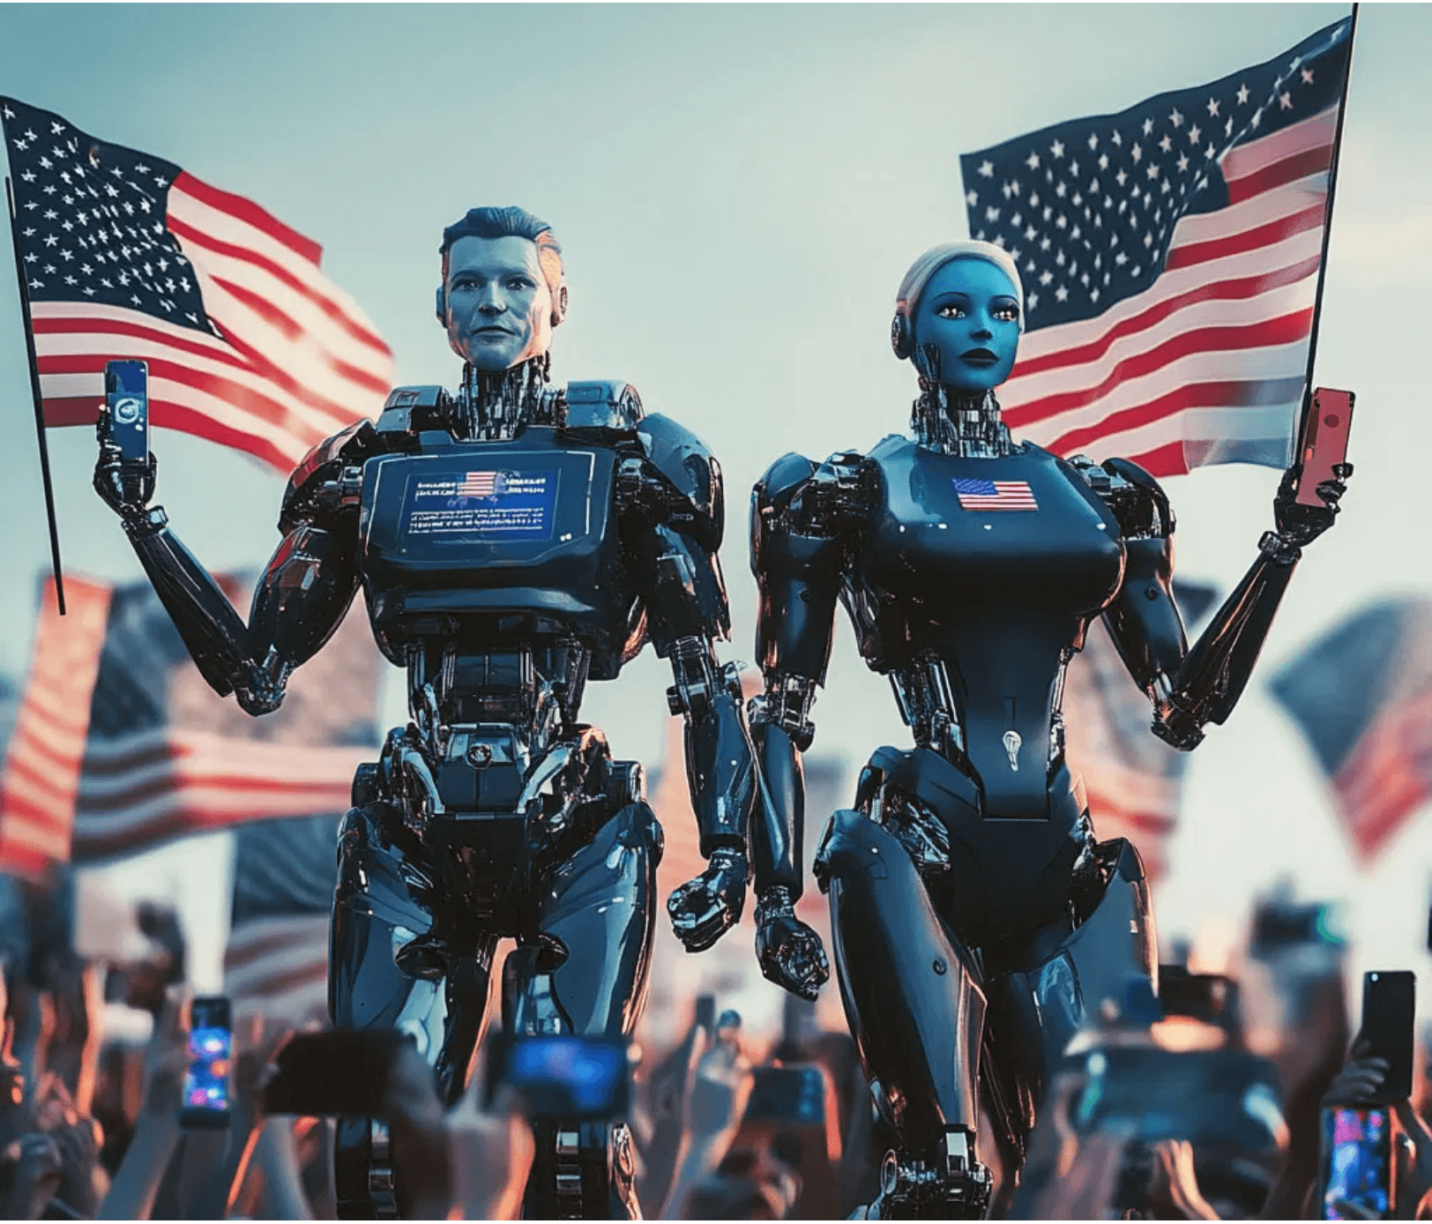
What is AI?
Definition
AI stands for Artificial Intelligence. It refers to computer systems designed to perform tasks that typically require human intelligence.
The Evolution of the Term
The definition of AI has changed significantly over time. Programs that play chess or control airplane autopilots were once called AI. However, as these challenges were solved, they became considered traditional computer programs rather than AI.
Modern AI Definition: Today, when people talk about AI, they usually refer to programs like ChatGPT—systems that can understand and respond to human language in remarkably human-like ways.
A Breakthrough Technology
ChatGPT represents a significant breakthrough in computing. You can access it from your computer or phone at chat.openai.com. Its impact can be seen in the stock market and investment trends.

Slide 3
AI vs Traditional Computing
Traditional Programs
Artificial Intelligence
How They Work
How They Work
Made by writing explicit rules and logic (e.g., "IF X THEN Y")
Trained on massive amounts of data rather than programmed with rules
Output
Predictable and based on pre-defined logic
Data Sources
YouTube videos, Wikipedia articles, Spotify songs, and billions of text samples
Examples
Chess programs, calculators, email filters
Core Technology
Known as Machine Learning, a field of computer science
Limitations
Cannot learn or adapt beyond their programming
Key Challenge
Requires enormous amounts of data—sometimes used without proper rights

Slide 4

The AI Boom and Economic Impact
The breakthrough in artificial intelligence technology has triggered a significant economic shift, visible across global financial markets.
Market Observation
The impact of this new breakthrough can be seen in the stock market
Investment capital is flowing rapidly into companies that enable AI infrastructure and development.
Investment Trend
Stock Performance
Money is flowing into companies that provide the essential hardware and software for AI systems.
Key hardware providers have seen dramatic increases in stock prices, reflecting massive investment in AI infrastructure.
Market Drivers
Global Impact
Companies racing to build data centers, acquire GPUs, and develop AI capabilities are driving valuations higher.
The AI boom is reshaping technology sectors and creating new opportunities across industries worldwide.

Slide 5
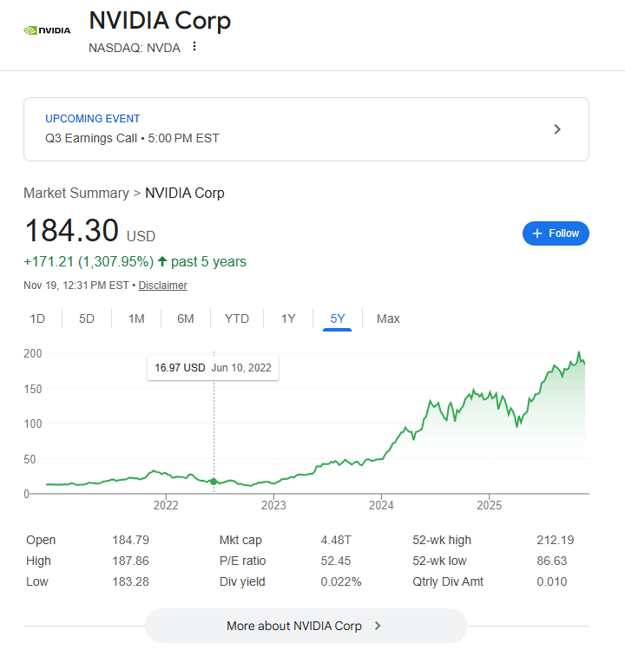
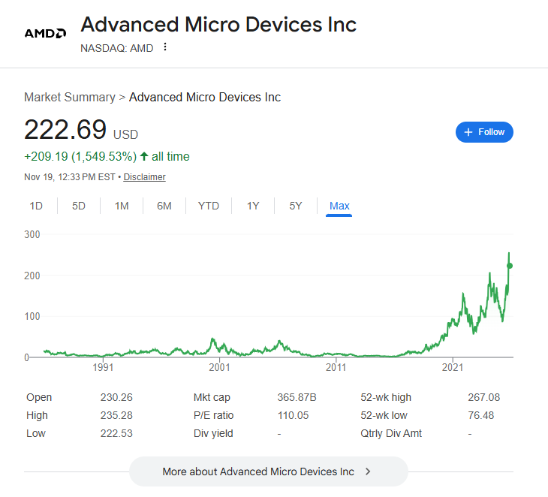

Slide 6
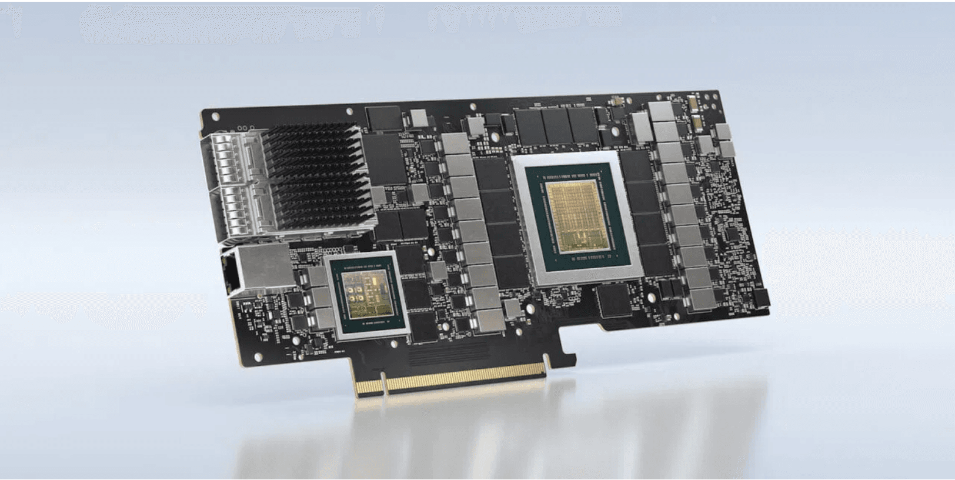
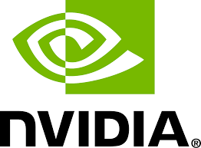



The Hardware Enablers: Nvidia and AMD
What is a GPU?
Nvidia and AMD create a critical computer component called a GPU (Graphics Processing Unit). Most computers need a GPU to function, but they are especially essential for AI applications.
Why GPUs for AI?
GPUs are designed to perform many calculations in parallel, making them ideal for training artificial intelligence models on massive datasets. This parallel processing power is what enables modern AI breakthroughs.
GPU:
Nvidia, AMD (parallel processing, AI training)
CPU:
Intel (sequential processing, general computing)
Market Competition
Nvidia currently dominates the AI chip market, but AMD is actively challenging this lead. Both companies are racing to provide the most powerful and efficient hardware for the booming AI industry.

Slide 7
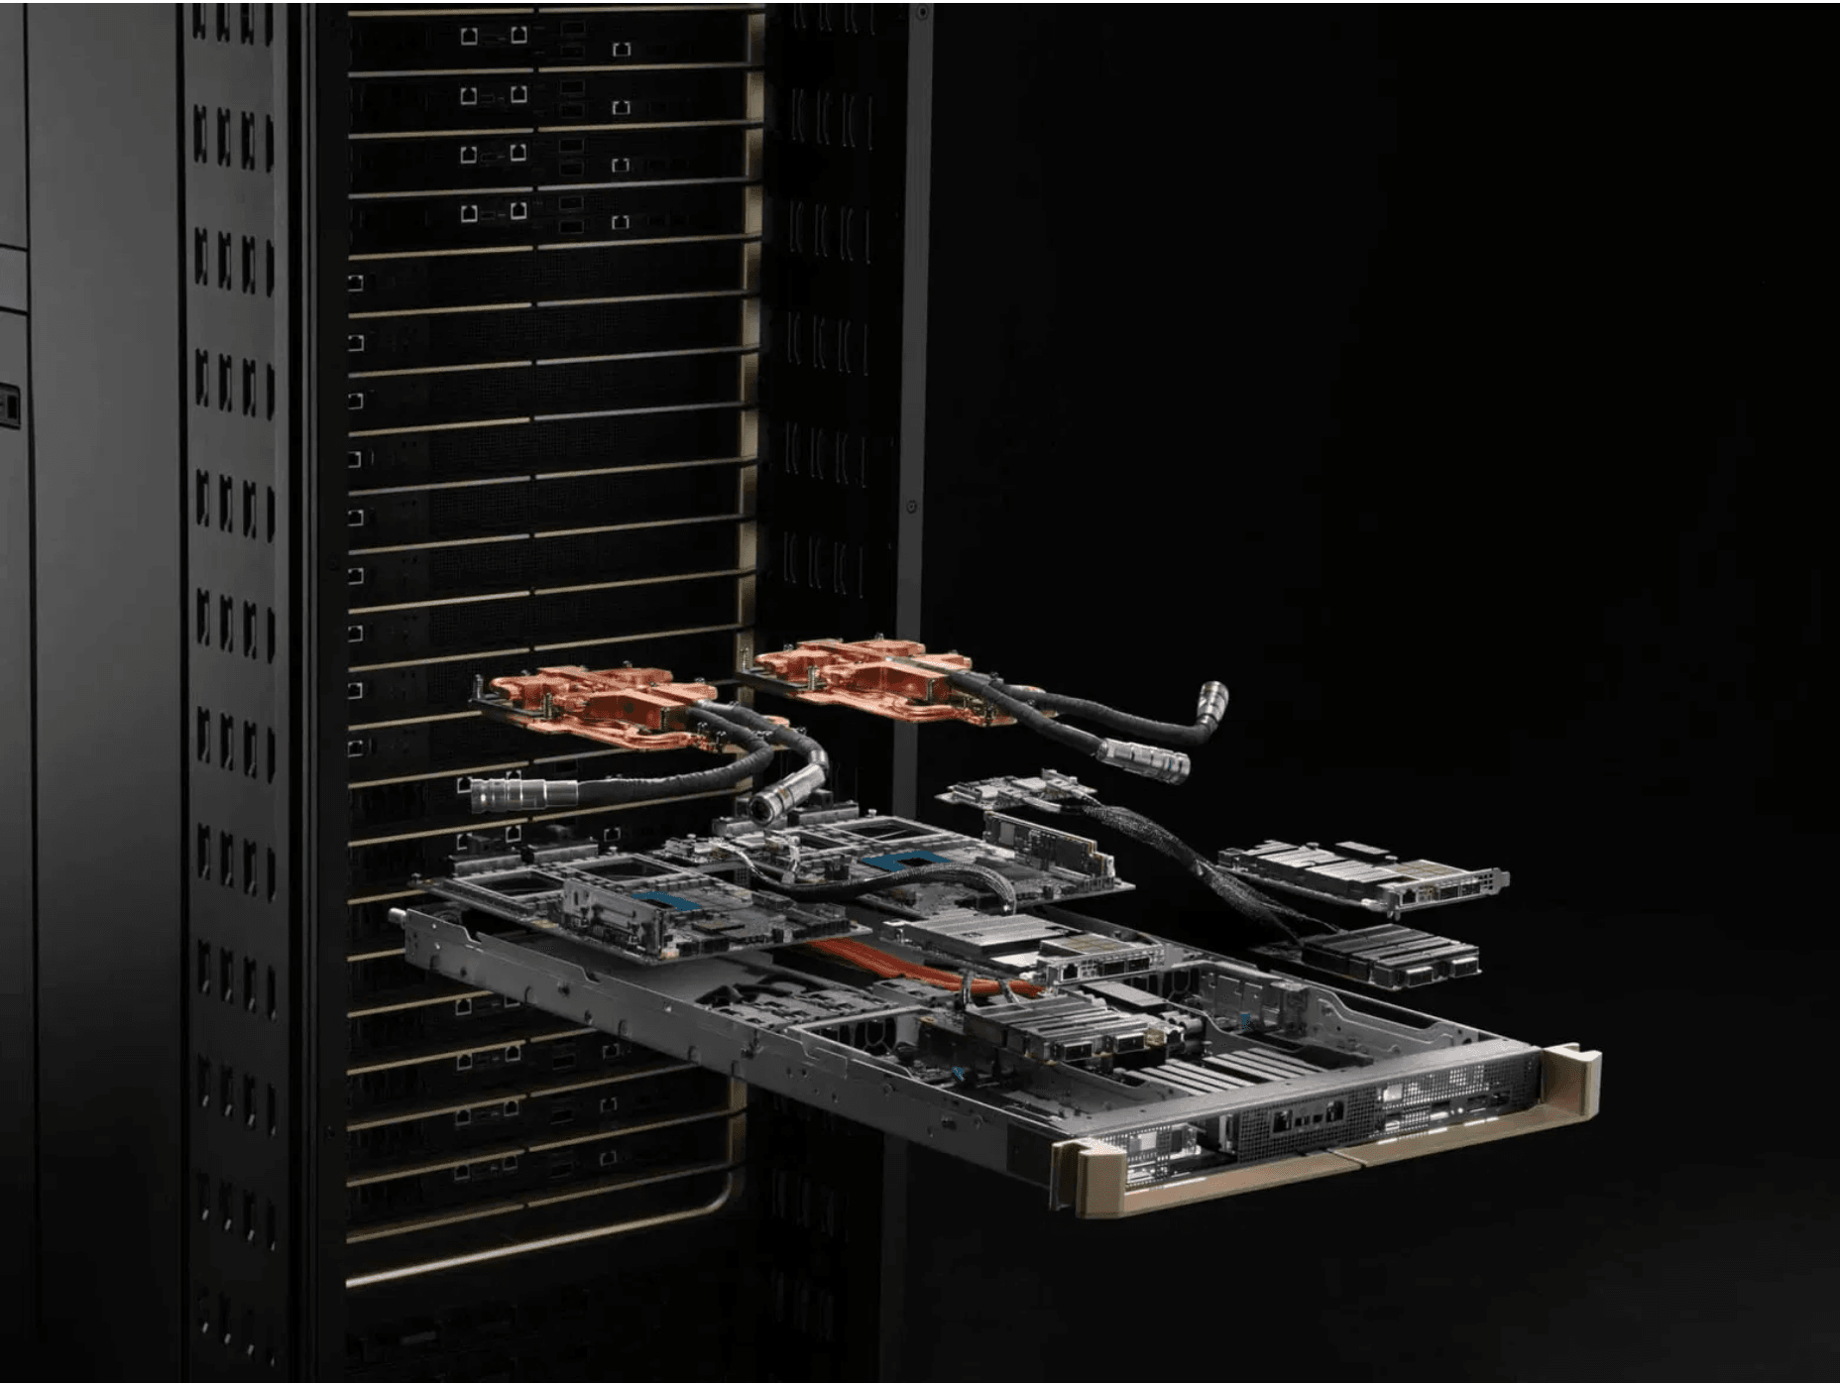
What are GPUs Used For?
Use 1
Gaming
GPUs provide high-performance graphics rendering, enabling smooth gameplay and realistic visual effects in modern video games.
Use 2
Cryptocurrency Mining
GPUs perform complex mathematical calculations required for blockchain operations and cryptocurrency mining, making them essential for this industry.
Use 3
Training Artificial Intelligence
The massive parallel processing power of GPUs is ideal for training machine learning models on enormous datasets, making them critical for AI development.

Slide 8

Common AI Products in the Wild
ChatGPT
Grok
The first widely available AI chatbot.
Elon Musk’s ChatGPT competitor with looser moderation.
Access:
Philosophy:
Available from computer or phone at chat.openai.com
Features fewer restrictions, appealing to the anti-censorship crowd
Capability:
Platform:
Responds to user queries in remarkably human-like ways
Heavily integrated into X (formerly Twitter) for unique social media use cases
DeepSeek
Cursor
A Chinese ChatGPT rival gaining global traction.
An AI IDE built for software developers.
Capability:
Use Case:
A very smart and capable AI chatbot with advanced reasoning abilities
Used to code software significantly faster than traditional methods
Market Position:
Impact:
Represents growing competition from non-Western AI developers
Enables developers to work 10 to 100 times faster on coding tasks

Slide 9
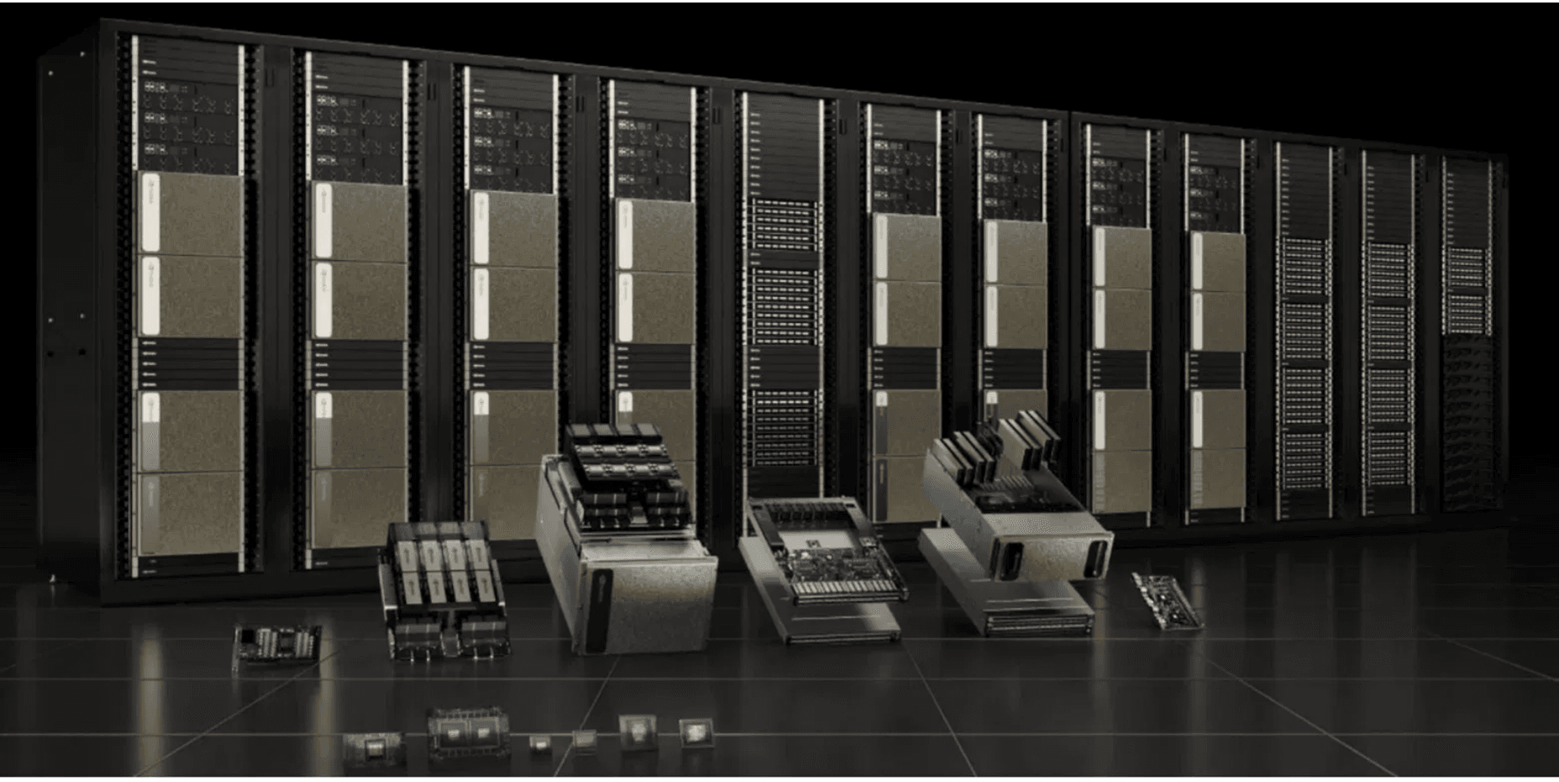
AI and Politics: Energy and Data Centers
The Infrastructure Challenge
Chips sold by Nvidia and AMD require massive amounts of electricity to function. Companies create enormous computer rooms called data centers to train and run AI systems.
2x
Growth by 2030
Data center energy demand is expected to more than double by 2030, making energy policy a critical political issue.
Current Energy Impact
Data centers accounted for approximately 4% of total U.S. electricity use in 2024, and this percentage is rapidly increasing as AI adoption accelerates.
Political Implications
Policies regarding electricity generation and electricity costs are now trending topics in political discourse. Governments must balance AI innovation with energy sustainability and affordability.

Slide 10


AI and Politics: Censorship and Free Speech
AI as a Censorship Tool
AI can be used to enforce censorship through automated content moderation, filtering, and removal of content deemed inappropriate or harmful.
Content Moderation Functions
AI systems automatically flag, filter, or remove content based on predefined rules, making moderation faster and more consistent at scale.
The Counter-Movement
In response, some AI systems like Grok are designed with fewer restrictions, appealing to those concerned about censorship and promoting freedom of expression.
Anti-Censorship Appeal
Grok's less-restricted approach has made it popular with communities that prioritize free speech and are skeptical of heavy-handed content moderation.
Political Implications
Policies regarding AI will inevitably relate to censorship and free expression in many ways. Governments must balance platform safety with freedom of speech, creating a complex policy landscape.

Slide 11
AI and Politics: National Security
The Core Risk
Using foreign-developed AI systems in critical national security tasks poses significant risks to national security infrastructure. When sensitive information is shared with these systems, that data could potentially be accessed or used by foreign governments.
The DeepSeek Example
DeepSeek is a capable Chinese AI system. If sensitive government or military information is shared with DeepSeek, that data could potentially be used against the United States by China. This creates a significant vulnerability in national security.
Data Security Concerns
Critical information shared with foreign AI systems—including military strategies, intelligence data, infrastructure details, or classified communications—could be intercepted, stored, or analyzed by foreign intelligence agencies. This represents a fundamental threat to national security.
Policy Implications
Governments must implement strict policies to ensure that trusted, secure AI systems are used for all critical national security tasks. This includes:
Domestic AI Preference
Vetting Requirements
Data Protection
Supply Chain Security
Prioritizing AI systems developed and controlled domestically for sensitive government operations
Establishing rigorous security audits and certifications for any AI used in national security contexts
Implementing strict protocols to prevent sensitive information from being shared with foreign AI systems
Ensuring that AI hardware and software components come from trusted, verified sources

Slide 12

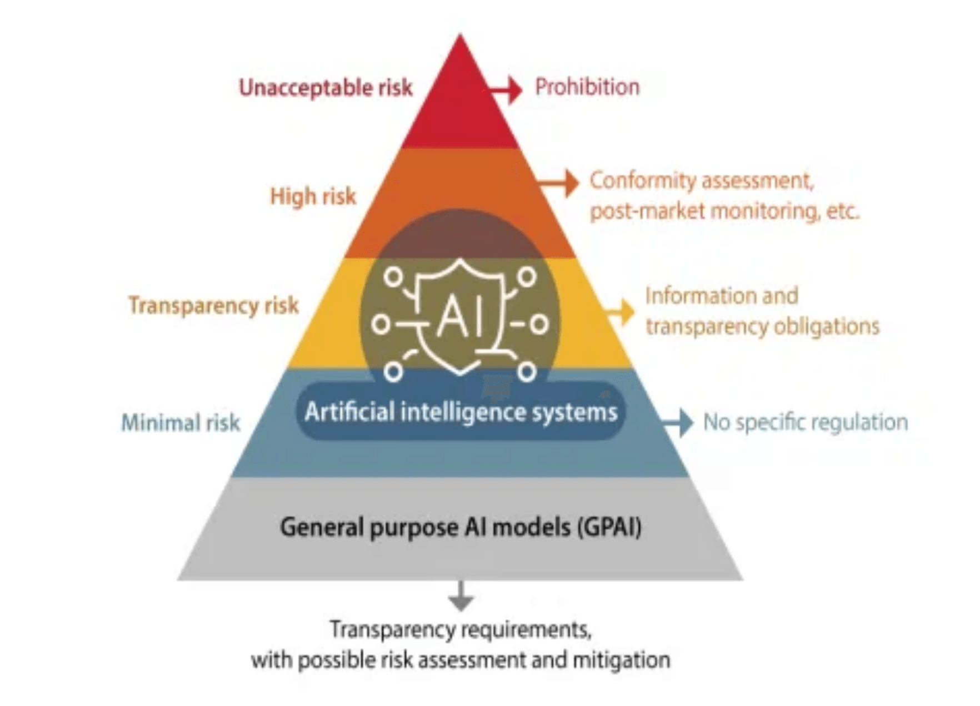
AI and Politics: Regulation
The Core Debate
Regulation can make AI develop faster or slower. Policymakers face a fundamental choice: should they accelerate AI innovation or implement safety guardrails?
Acceleration Approach
Policies that promote innovation, funding, and open access to data and models. This approach prioritizes economic growth and technological leadership.
Deceleration/Safety Approach
Policies that impose safety guardrails, ethical guidelines, and licensing requirements. This approach prioritizes risk mitigation and societal protection.
Key Considerations
Policymakers must weigh the benefits of acceleration (economic growth, technological leadership) against the risks that necessitate deceleration (safety, misuse, societal impact).
Political Implications
The regulatory choices made today will shape the future of technology, the global economy, and democratic societies for decades to come.

Slide 13

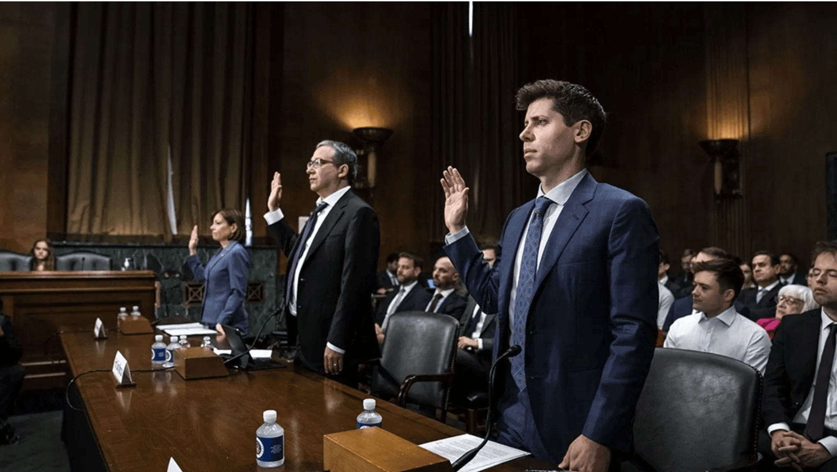
Conclusion: The Political Future of AI
Key Takeaway 1
AI is a Fundamental Shift
AI represents a fundamental transformation in computing, driven by massive datasets and specialized hardware (GPUs). This is not an incremental improvement but a paradigm shift.
Key Takeaway 2
Economic Impact is Profound
The economic impact is visible in stock markets, with companies like Nvidia and AMD experiencing dramatic growth. Investment capital is flowing rapidly into AI infrastructure.
Key Takeaway 3
Four Political Pillars
Political discussions center on Energy (data center power), Censorship (content moderation), National Security (foreign AI risks), and Regulation (innovation vs. safety).
The decisions made today about AI policy will shape the future of technology, economy, and democracy. Informed policymaking is essential.

